Slide 1
Global Prevalence and Burden of Mental Health Disorders
Exploratory Data Analysis (EDA)
Luna Pérez Troncoso

Slide 2
INDEX
Introduction
01
04
Metrics and Classifications
Objectives
02
05
Results
Data information
03
06
Conclusions

Slide 3
INDEX
Introduction
01
04
Metrics and Classifications
Objectives
02
05
Results
Data information
03
06
Conclusions

Slide 4
INDEX
Introduction
01
04
Metrics and Classifications
Objectives
02
05
Results
Data information
03
06
Conclusions

Slide 5
INDEX
Introduction
01
04
Metrics and Classifications
Objectives
02
05
Results
Data information
03
06
Conclusions

Slide 6
INDEX
Introduction
01
04
Metrics and Classifications
Objectives
02
05
Results
Data information
03
06
Conclusions

Slide 7
INDEX
Introduction
01
04
Metrics and Classifications
Objectives
02
05
Results
Data information
03
06
Conclusions

Slide 8
INTRODUCTION
Mental health plays a fundamental role in the overall well-being of individuals and the stability of societies

Slide 9
INTRODUCTION
Mental health plays a fundamental role in the overall well-being of individuals and the stability of societies
When mental health deteriorates, the consequences extend beyond the individual, affecting families, workplaces, and communities at large

Slide 10
INTRODUCTION
Mental health plays a fundamental role in the overall well-being of individuals and the stability of societies
When mental health deteriorates, the consequences extend beyond the individual, affecting families, workplaces, and communities at large
Mental health disorders represent a growing public health concern.

Slide 11
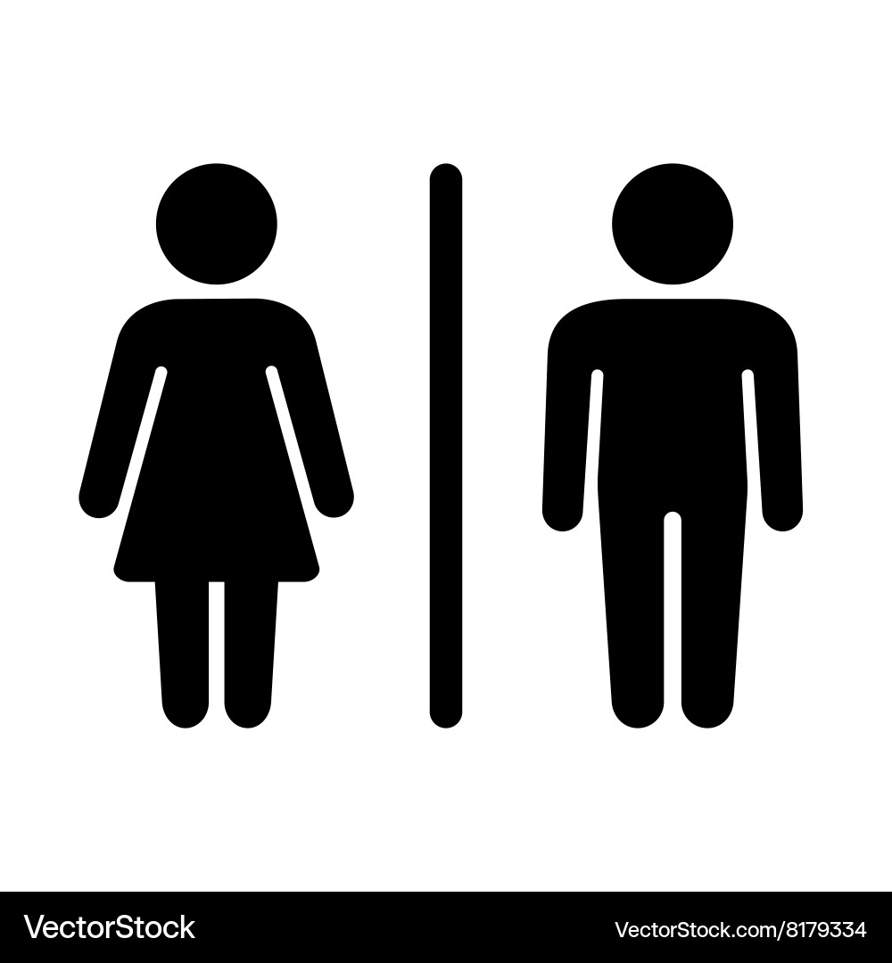

INTRODUCTION
Mental health plays a fundamental role in the overall well-being of individuals and the stability of societies
When mental health deteriorates, the consequences extend beyond the individual, affecting families, workplaces, and communities at large
Mental health disorders represent a growing public health concern.

Slide 12
INTRODUCTION
Mental health plays a fundamental role in the overall well-being of individuals and the stability of societies
When mental health deteriorates, the consequences extend beyond the individual, affecting families, workplaces, and communities at large
Mental health disorders represent a growing public health concern.

Slide 13
INTRODUCTION
Mental health plays a fundamental role in the overall well-being of individuals and the stability of societies
When mental health deteriorates, the consequences extend beyond the individual, affecting families, workplaces, and communities at large
Mental health disorders represent a growing public health concern.
One in three women and one in five men will experience a major depressive episode at some point in their lives.

Slide 14
OBJECTIVES
This exploratory data analysis (EDA) aims to investigate the global prevalence and burden of mental health disorders across countries, continents, and socioeconomic regions.

Slide 15
OBJECTIVES
This exploratory data analysis (EDA) aims to investigate the global prevalence and burden of mental health disorders across countries, continents, and socioeconomic regions.
By identifying global trends and potential contributing factors, this analysis seeks to provide a clearer understanding of how mental health challenges manifest across different populations and what patterns may inform prevention and intervention strategies

Slide 16
DATA INFORMATION

Slide 17
DATA INFORMATION
Data Sources
100
75
50
25

Slide 18
DATA INFORMATION
Data Sources
Data comes from a kaggle dataset shared by Mohamadreza Momeni. This data was collected through OurWorldInData platform from Global Burden of Disease study by Institute for Health Metrics and Evaluation (GBD-IHME) from the University of Washington and World Health Organization (WHO)
100
75
50
25

Slide 19

DATA INFORMATION
Data Sources
Data comes from a kaggle dataset shared by Mohamadreza Momeni. This data was collected through OurWorldInData platform from Global Burden of Disease study by Institute for Health Metrics and Evaluation (GBD-IHME) from the University of Washington and World Health Organization (WHO)
100
75
50
25

Slide 20

DATA INFORMATION
Data Sources
Data comes from a kaggle dataset shared by Mohamadreza Momeni. This data was collected through OurWorldInData platform from Global Burden of Disease study by Institute for Health Metrics and Evaluation (GBD-IHME) from the University of Washington and World Health Organization (WHO)
100
75
50
25

Slide 21


DATA INFORMATION
Data Sources
Data comes from a kaggle dataset shared by Mohamadreza Momeni. This data was collected through OurWorldInData platform from Global Burden of Disease study by Institute for Health Metrics and Evaluation (GBD-IHME) from the University of Washington and World Health Organization (WHO)
100
75
50
25

Slide 22
DATA INFORMATION
Data Sources
Data comes from a kaggle dataset shared by Mohamadreza Momeni. This data was collected through OurWorldInData platform from Global Burden of Disease study by Institute for Health Metrics and Evaluation (GBD-IHME) from the University of Washington and World Health Organization (WHO)
100
75
50
25

Slide 23
DATA INFORMATION
Data Sources
Data comes from a kaggle dataset shared by Mohamadreza Momeni. This data was collected through OurWorldInData platform from Global Burden of Disease study by Institute for Health Metrics and Evaluation (GBD-IHME) from the University of Washington and World Health Organization (WHO)
100
Classification Criteria
75
50
25

Slide 24

DATA INFORMATION
Data Sources
Data comes from a kaggle dataset shared by Mohamadreza Momeni. This data was collected through OurWorldInData platform from Global Burden of Disease study by Institute for Health Metrics and Evaluation (GBD-IHME) from the University of Washington and World Health Organization (WHO)
100
Classification Criteria
Geographic regions were divided using World Health Organization (WHO) criteria, whereas economic classification of the countries by level of income followed the criteria established by World Bank (WB)
75
50
25

Slide 25
DATA INFORMATION
Data Sources
Data comes from a kaggle dataset shared by Mohamadreza Momeni. This data was collected through OurWorldInData platform from Global Burden of Disease study by Institute for Health Metrics and Evaluation (GBD-IHME) from the University of Washington and World Health Organization (WHO)
100
Classification Criteria
Geographic regions were divided using World Health Organization (WHO) criteria, whereas economic classification of the countries by level of income followed the criteria established by World Bank (WB)
75
50
25

Slide 26
DATA INFORMATION
Data Sources
Data comes from a kaggle dataset shared by Mohamadreza Momeni. This data was collected through OurWorldInData platform from Global Burden of Disease study by Institute for Health Metrics and Evaluation (GBD-IHME) from the University of Washington and World Health Organization (WHO)
100
Classification Criteria
Geographic regions were divided using World Health Organization (WHO) criteria, whereas economic classification of the countries by level of income followed the criteria established by World Bank (WB)
75
50
Health Metrics
25

Slide 27
DATA INFORMATION
Data Sources
Data comes from a kaggle dataset shared by Mohamadreza Momeni. This data was collected through OurWorldInData platform from Global Burden of Disease study by Institute for Health Metrics and Evaluation (GBD-IHME) from the University of Washington and World Health Organization (WHO)
100
Classification Criteria
Geographic regions were divided using World Health Organization (WHO) criteria, whereas economic classification of the countries by level of income followed the criteria established by World Bank (WB)
75
50
Health Metrics
25
Prevalence data is expressed in percentages of prevalence, whereas burden is measured by Disability-Adjusted Life Years (DALYs) rate per 100.000 Population.

Slide 28
¿What are the geographic regions of the WHO?

Slide 29
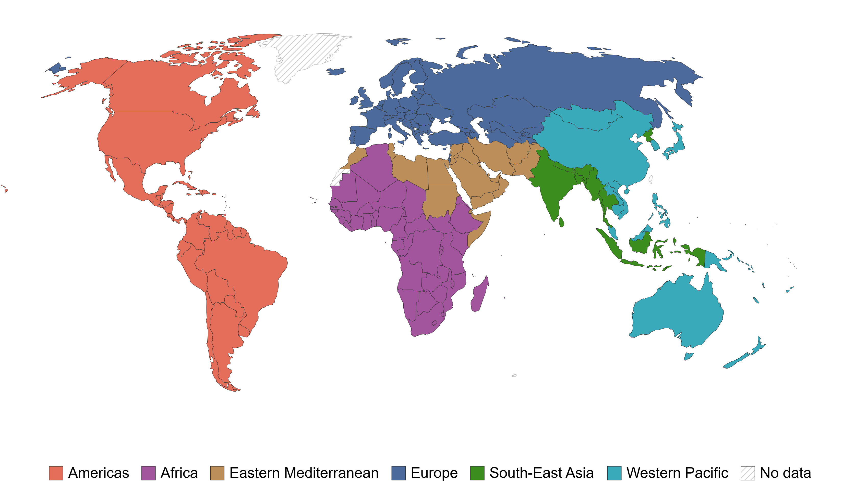
¿What are the geographic regions of the WHO?

Slide 30
¿What is the economic classificacion of the WB?

Slide 31
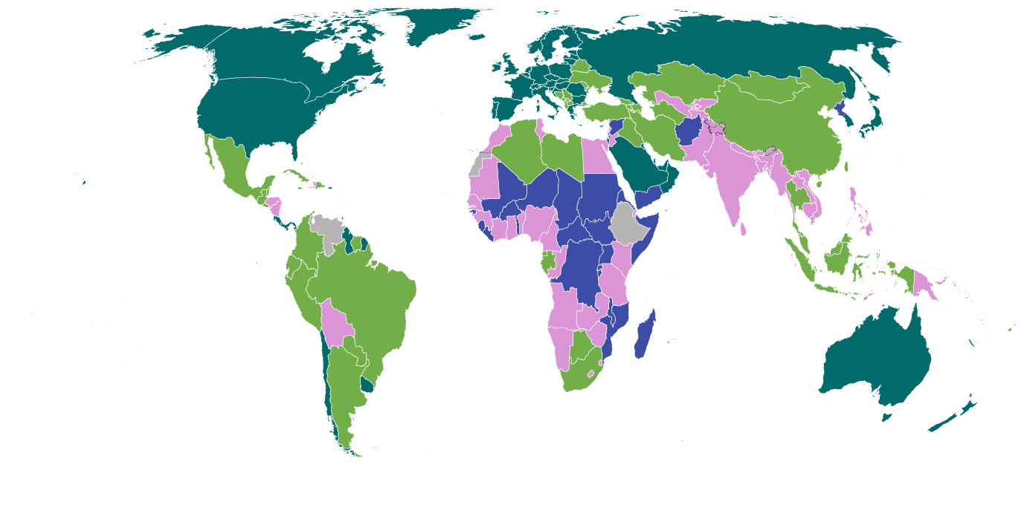
¿What is the economic classificacion of the WB?

Slide 32
¿What is the DALYs rate?

Slide 33
¿What is the DALYs rate?
Disability-adjusted life years (DALYs) represent the sum of years lost to premature death and years lived with disability.

Slide 34
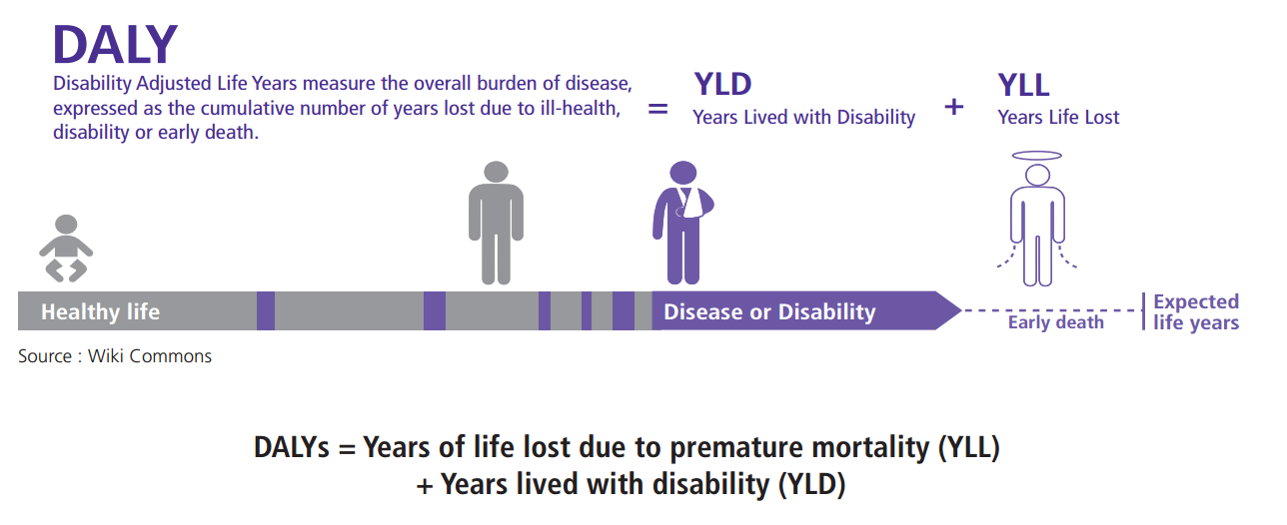
¿What is the DALYs rate?
Disability-adjusted life years (DALYs) represent the sum of years lost to premature death and years lived with disability.

Slide 35
RESULTS

Slide 36
Global mental health disorders prevalence and burden analysis

Slide 37
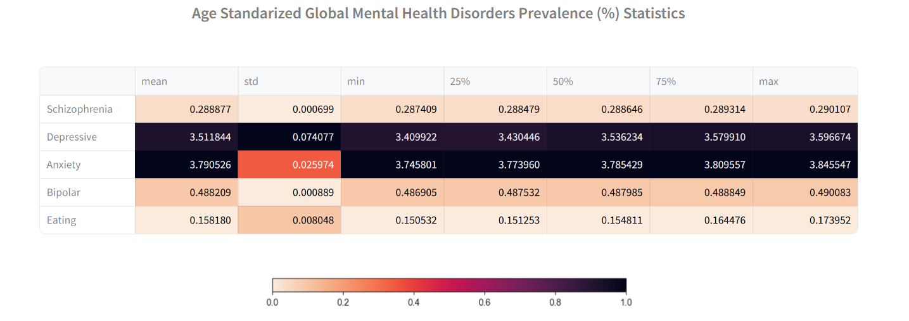
Global mental health disorders prevalence and burden analysis

Slide 38
Global mental health disorders prevalence and burden analysis

Slide 39
Global mental health disorders prevalence and burden analysis

Slide 40
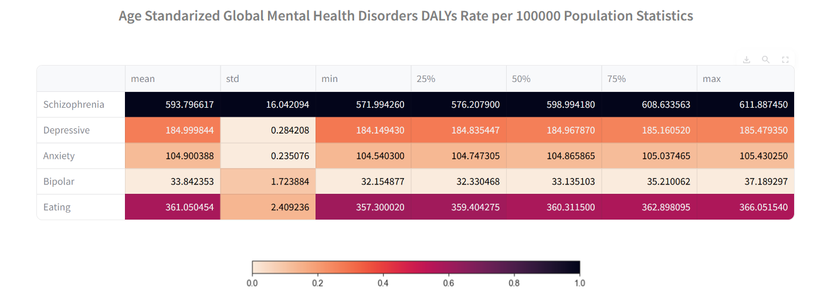
Global mental health disorders prevalence and burden analysis

Slide 41
Cross-country mental health disorders metrics

Slide 42
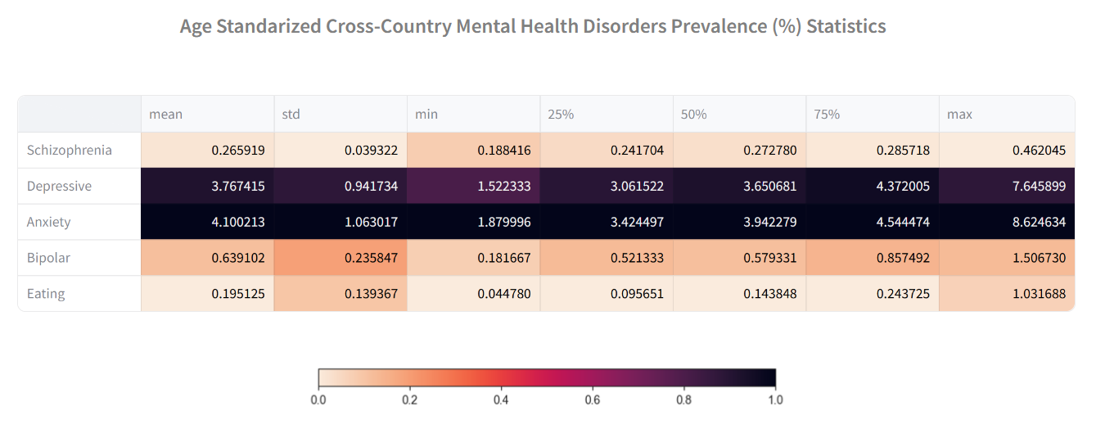
Cross-country mental health disorders metrics

Slide 43
Cross-country mental health disorders metrics

Slide 44
Cross-country mental health disorders metrics

Slide 45
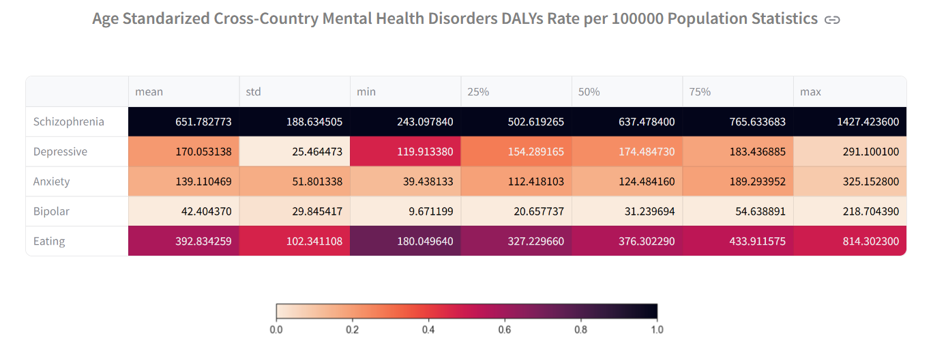
Cross-country mental health disorders metrics

Slide 46
Cross-country mental health disorders metrics distribution

Slide 47
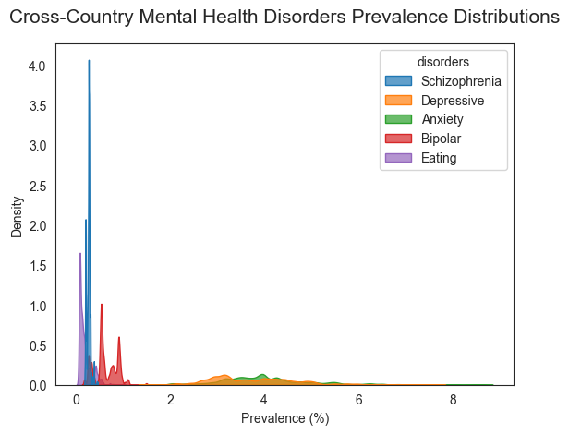
Cross-country mental health disorders metrics distribution

Slide 48
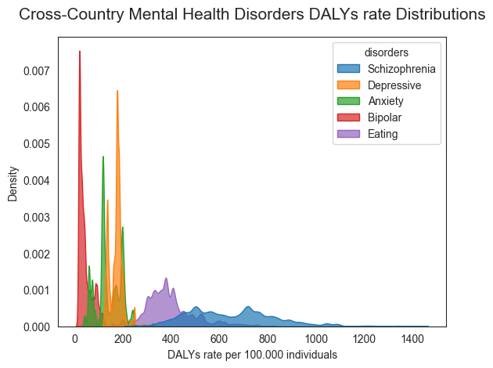
Cross-country mental health disorders metrics distribution

Slide 49
Cross-country progression mental health disorders

Slide 50
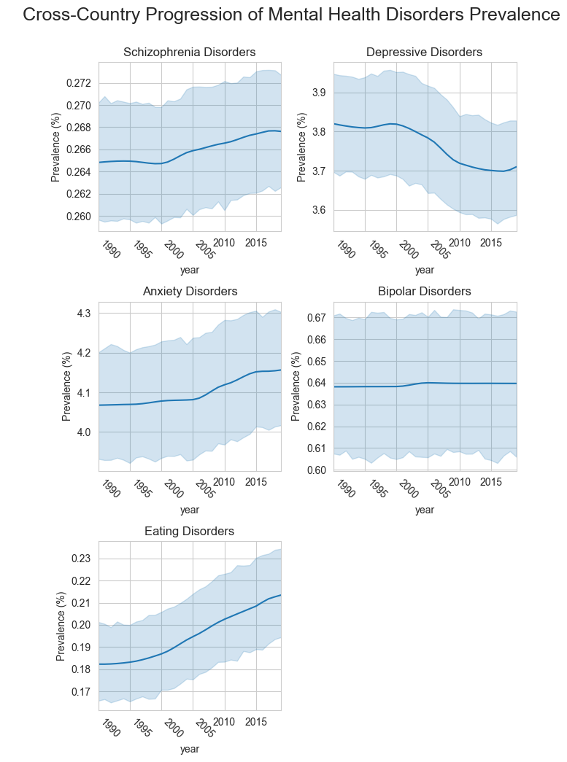
Cross-country progression mental health disorders

Slide 51
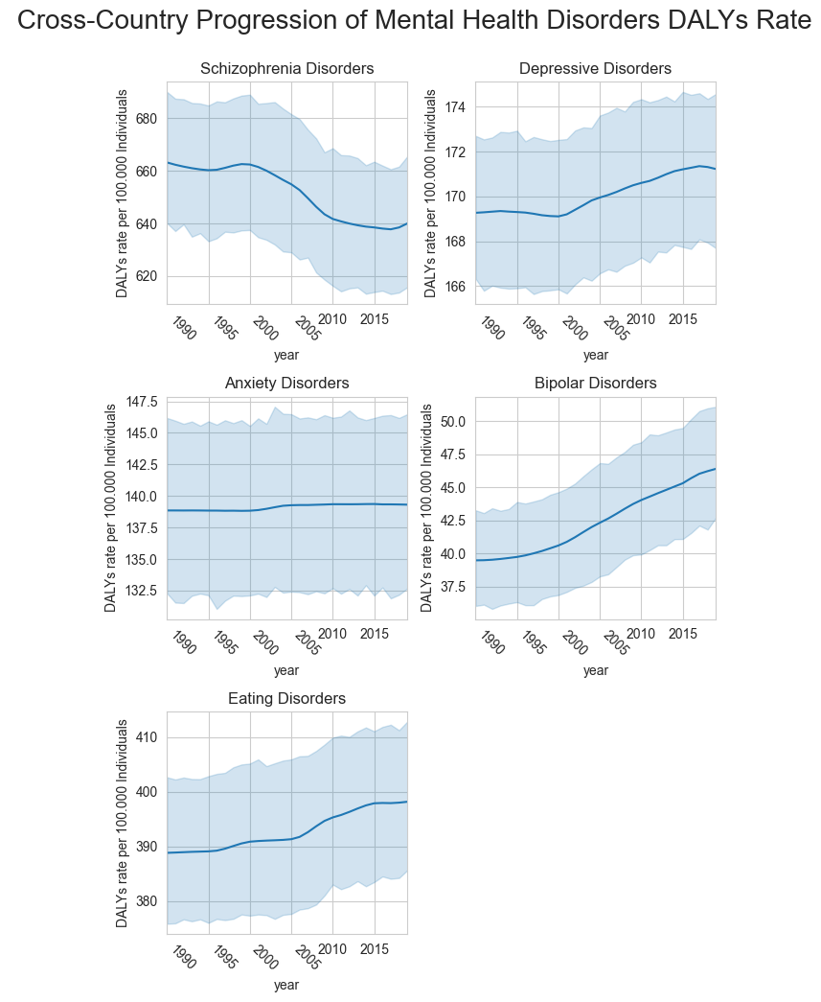
Cross-country progression mental health disorders

Slide 52
Cross-country progression mental health disorders
****
****
****
****
****
*
****
***
****
****
* p-values < 0.05
*** p-values < 0.001
**** p-values < 0.0001

Slide 53
Cross-country progression mental health disorders
****
****
****
****
****
*
****
***
****
****
* p-values < 0.05
*** p-values < 0.001
**** p-values < 0.0001

Slide 54
Cross-country progression mental health disorders
****
****
****
****
****
****
*
****
***
****
****
* p-values < 0.05
*** p-values < 0.001
**** p-values < 0.0001
↑17%

Slide 55
Cross-country progression mental health disorders
****
****
****
****
****
****
*
****
***
****
****
↑17%
* p-values < 0.05
*** p-values < 0.001
**** p-values < 0.0001
↑13%

Slide 56
Progression of mental health disorders by geographic region

Slide 57
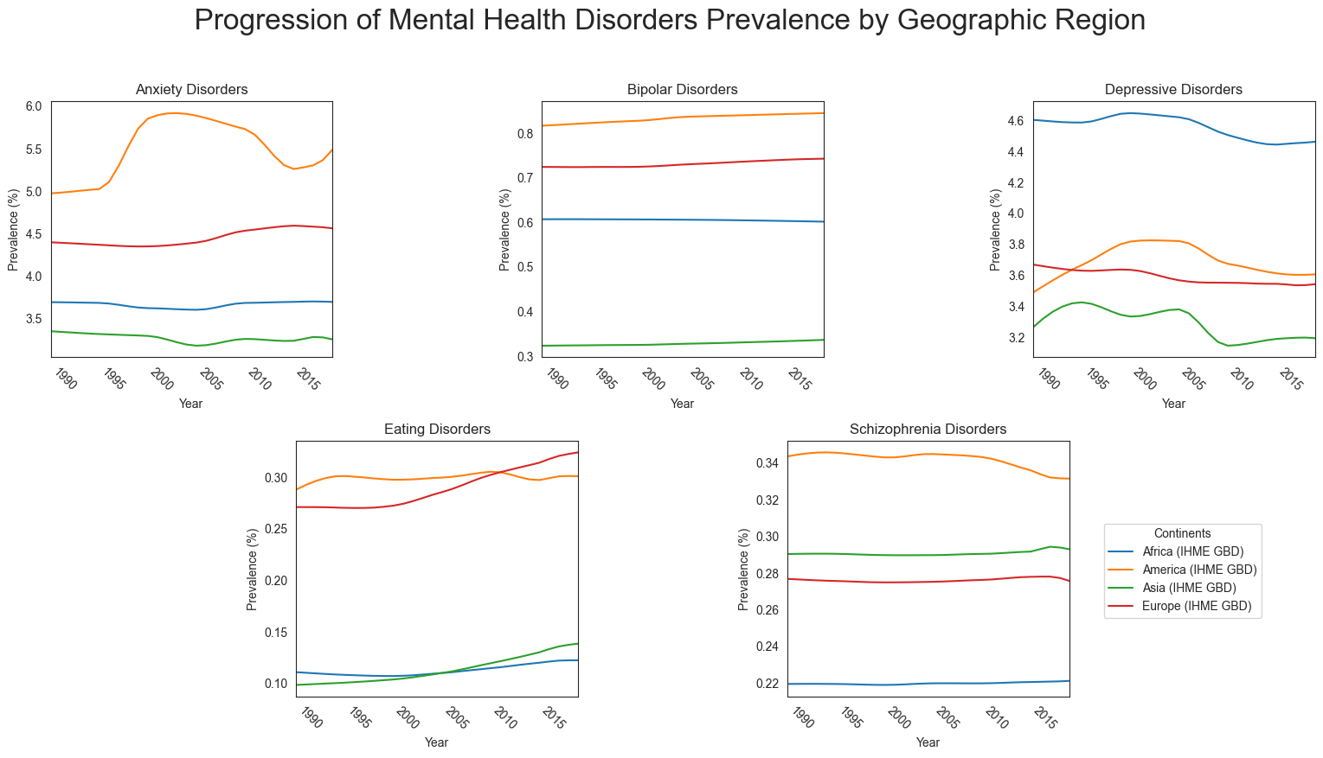
Progression of mental health disorders by geographic region

Slide 58
Progression of mental health disorders by geographic region

Slide 59
Progression of mental health disorders by geographic region

Slide 60
Progression of mental health disorders by geographic region

Slide 61
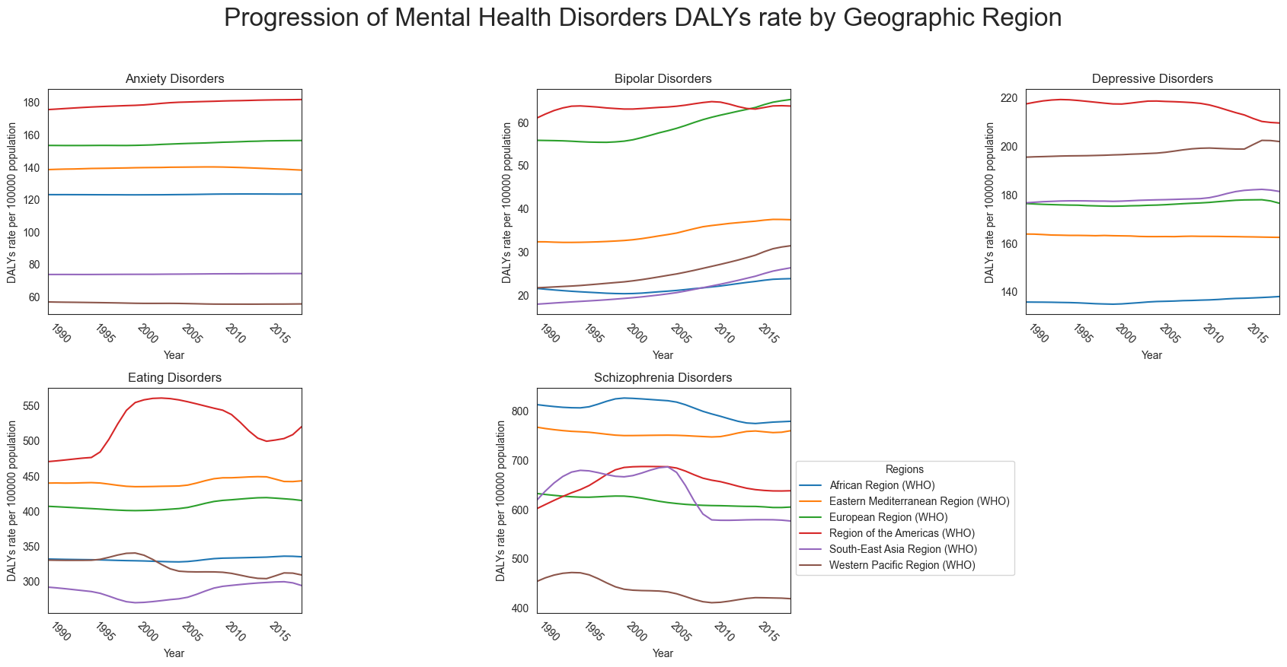

Progression of mental health disorders by geographic region

Slide 62
Progression of mental health disorders by geographic region

Slide 63
Progression of mental health disorders by geographic region

Slide 64
Mental health disorders by geographic region

Slide 65
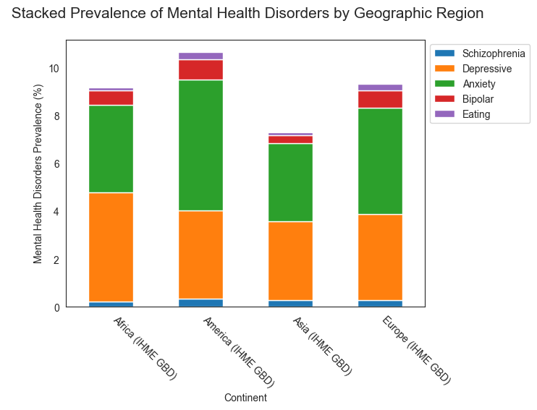
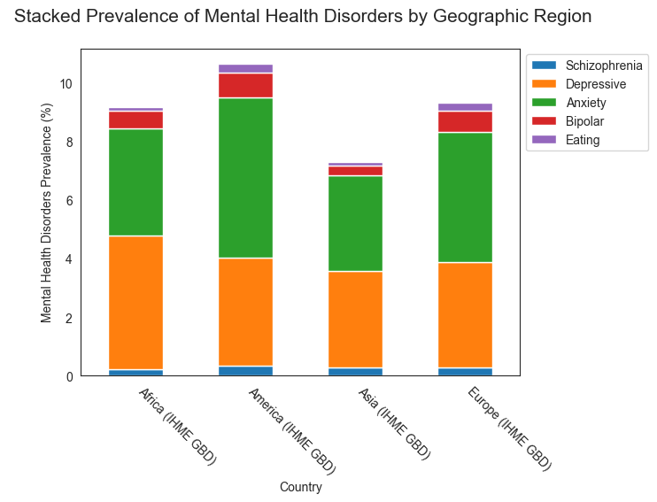
Mental health disorders by geographic region

Slide 66
Mental health disorders by geographic region
****
****
****
****
**** p-values < 0.0001

Slide 67
Mental health disorders by geographic region
****
****
****
****
**** p-values < 0.0001
p-values < 10^(-20) !

Slide 68
Mental health disorders by geographic region
****
↑29%
****
****
****
**** p-values < 0.0001

Slide 69
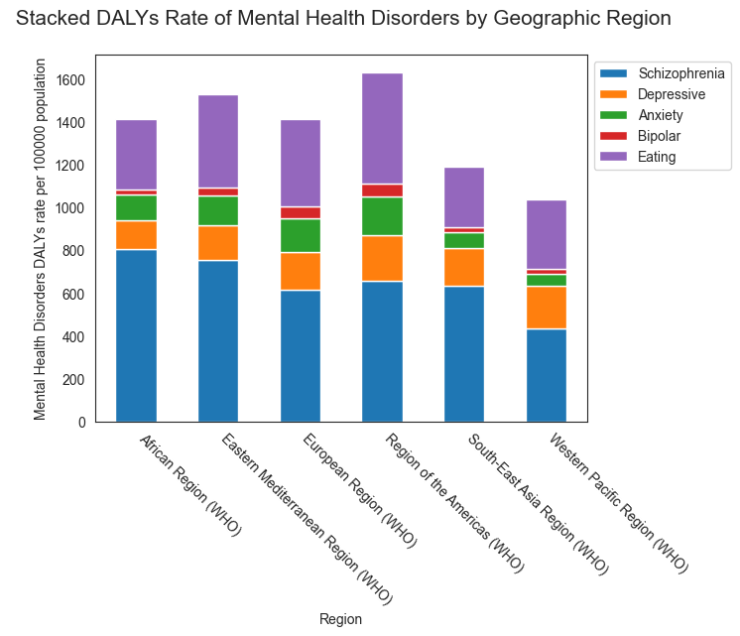
Mental health disorders by geographic region

Slide 70
Mental health disorders by geographic region
↑27%

Slide 71
Progression of mental health disorders by Income Level

Slide 72
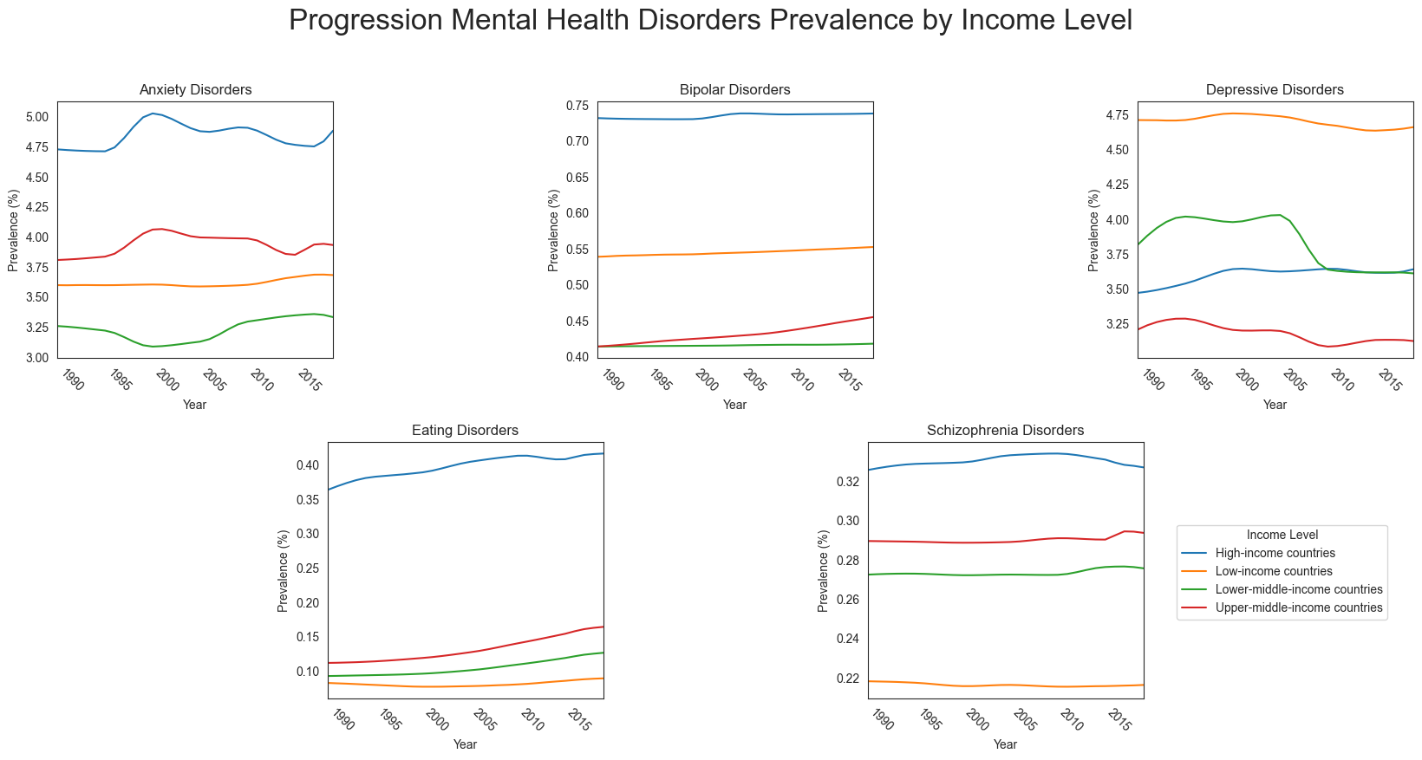
Progression of mental health disorders by Income Level

Slide 73
Progression of mental health disorders by Income Level

Slide 74
Progression of mental health disorders by Income Level

Slide 75
Progression of mental health disorders by Income Level

Slide 76
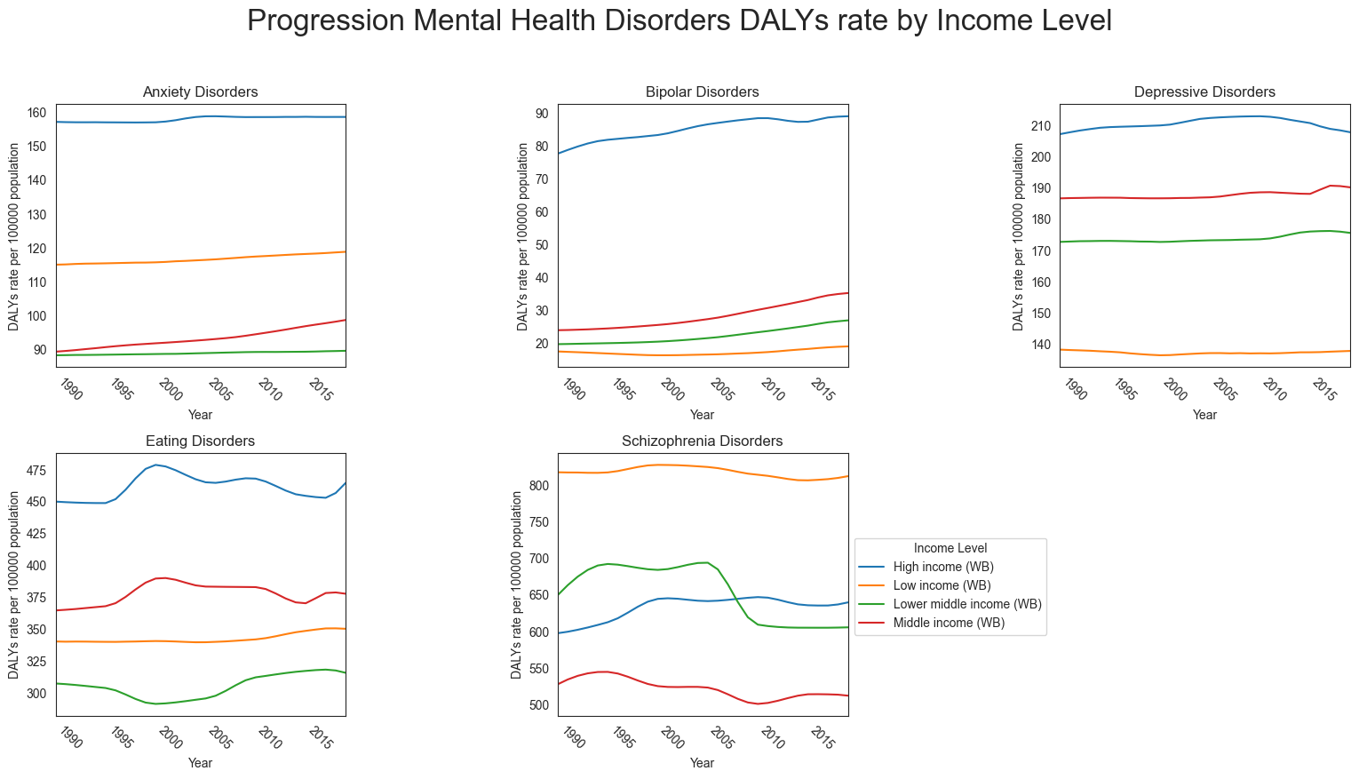
Progression of mental health disorders by Income Level

Slide 77
Progression of mental health disorders by Income Level

Slide 78
Progression of mental health disorders by Income Level

Slide 79
Mental health disorders by Income Level

Slide 80
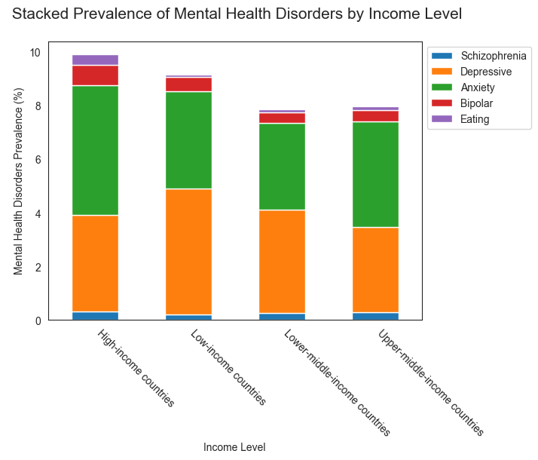
Mental health disorders by Income Level

Slide 81
Mental health disorders by Income Level
****
****
****
****
**** p-values < 0.0001

Slide 82
Mental health disorders by Income Level
****
****
****
****
**** p-values < 0.0001
p-values < 10^(-10) !

Slide 83
Mental health disorders by Income Level
****
↑20%
****
****
****
**** p-values < 0.0001

Slide 84
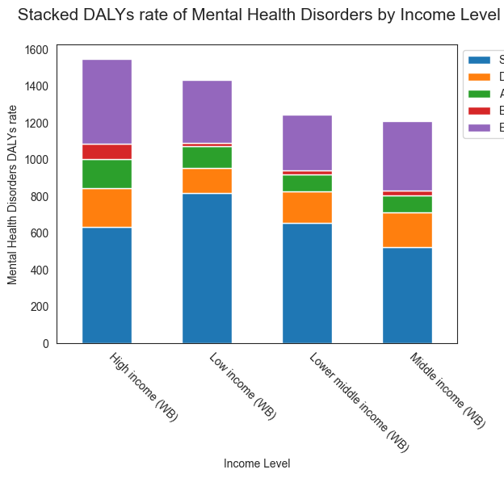
Mental health disorders by Income Level
****
****
****
****
**** p-values < 0.0001

Slide 85
Mental health disorders by Income Level
****
****
****
****
****
****
****
****
**** p-values < 0.0001

Slide 86
Mental health disorders by Income Level
****
****
↑21%
****
****
****
****
****
****
**** p-values < 0.0001

Slide 87
Mental health disorders prevalence and burden analysis by country

Slide 88
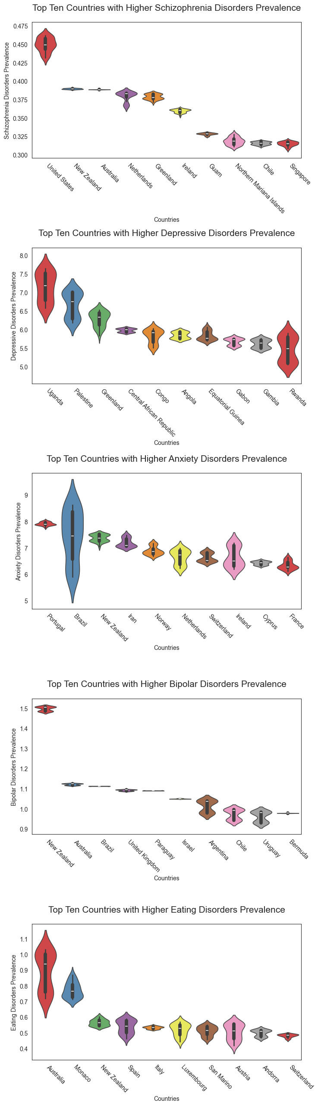
Mental health disorders prevalence and burden analysis by country

Slide 89
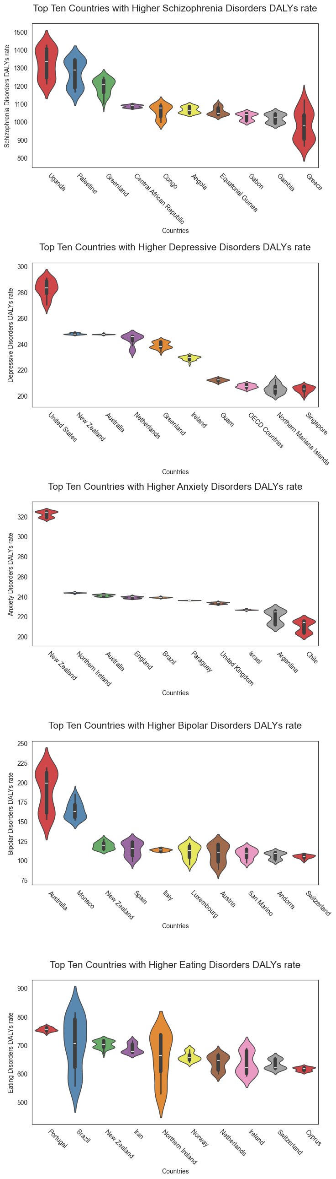
Mental health disorders prevalence and burden analysis by country

Slide 90
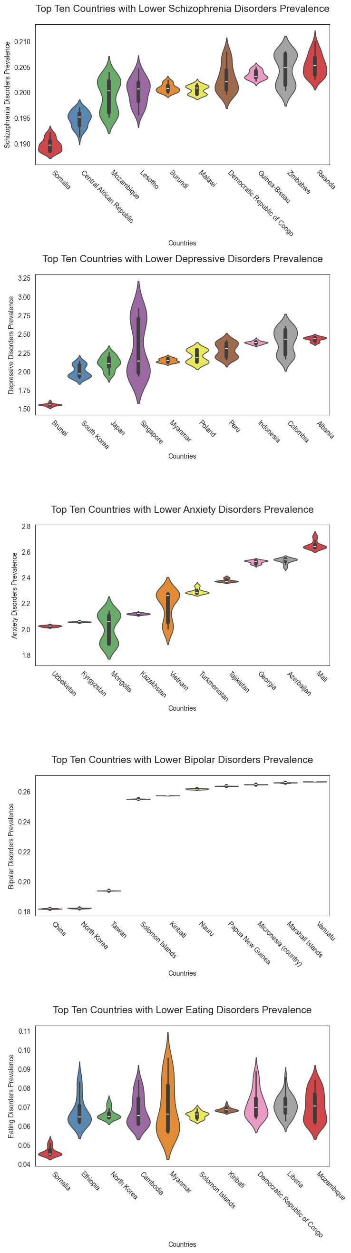
Mental health disorders prevalence and burden analysis by country

Slide 91
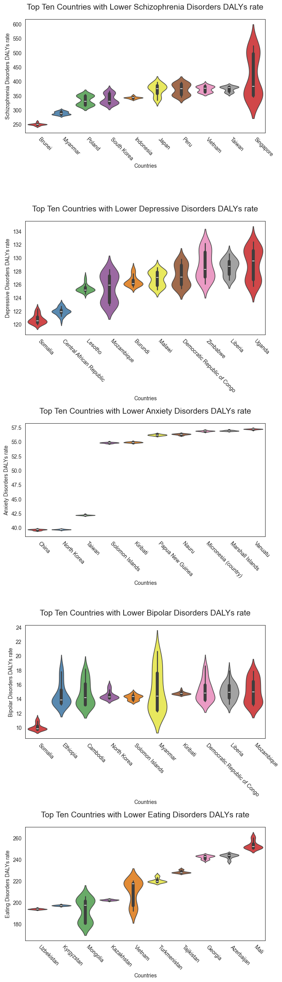
Mental health disorders prevalence and burden analysis by country

Slide 92
Mental health disorders metrics correlations

Slide 93
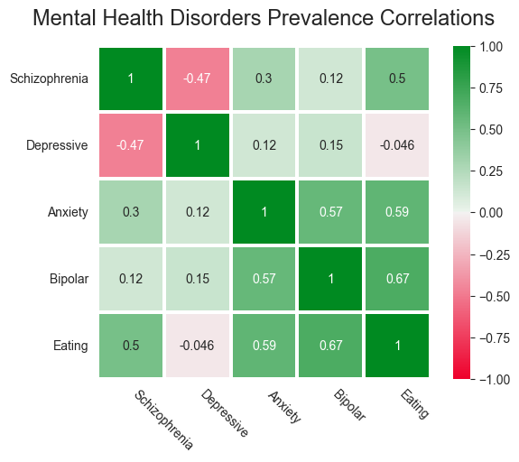
Mental health disorders metrics correlations

Slide 94
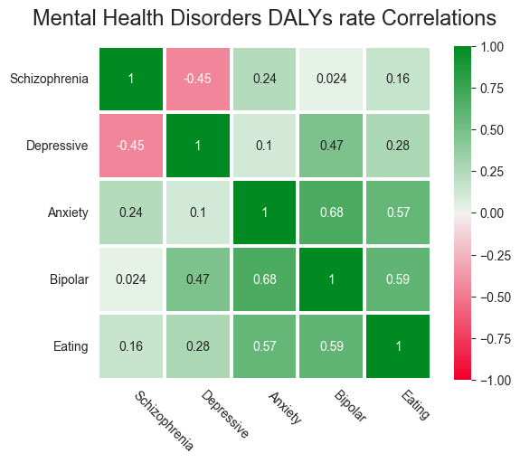
Mental health disorders metrics correlations

Slide 95
Mental health disorders metrics correlations

Slide 96
Mental health disorders metrics correlations

Slide 97
Mental health disorders metrics correlations

Slide 98
Mental health disorders metrics correlations

Slide 99
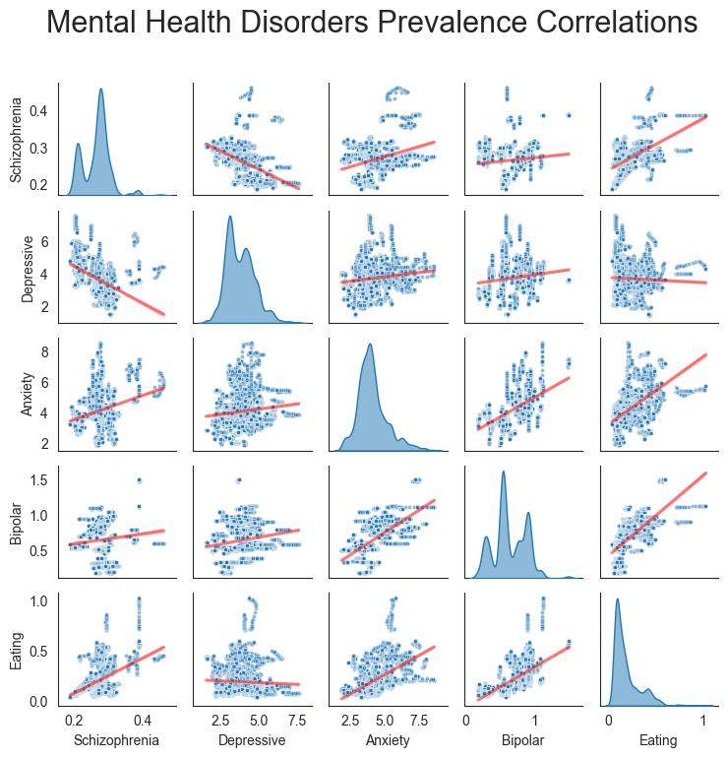
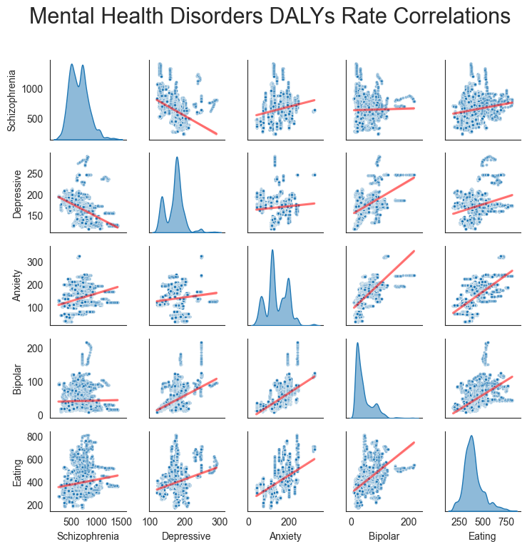
Mental health disorders metrics correlations

Slide 100
Mental health disorders metrics correlations

Slide 101
Mental health disorders metrics correlations

Slide 102
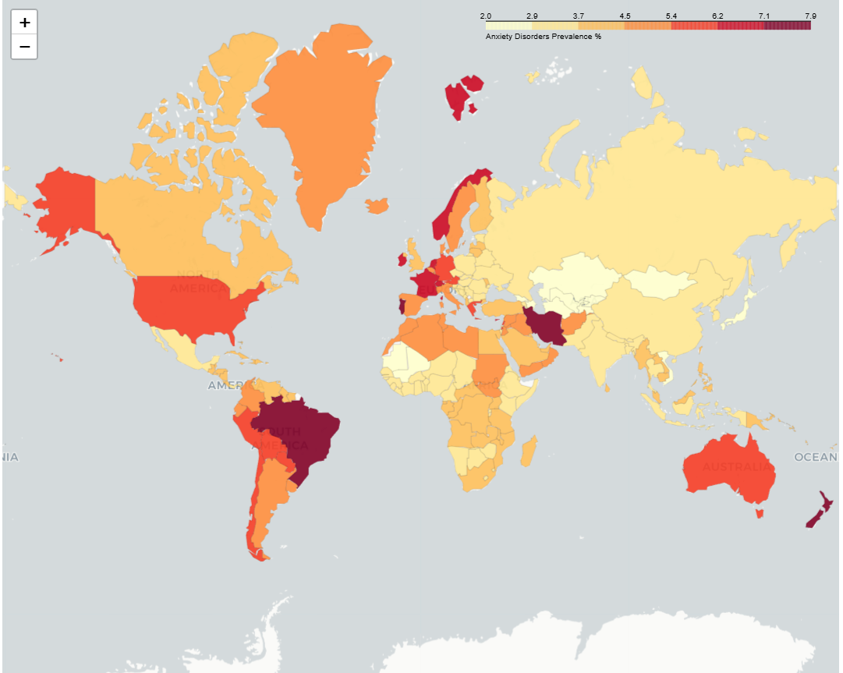
Mental health disorders metrics correlations

Slide 103
Mental health disorders metrics correlations
In order to have an interactive experience with the choropleth maps visit this:
Streamlit Webpage

Slide 104
MENTAL HEALTH INFOGRAPHICS
Mercury
Saturn
Mercury is the closest planet to the Sun and the smallest one
It's composed of hydrogen and helium. It was named after a Roman god
Mars
Venus
Despite being red, Mars is actually a cold place. It’s full of iron oxide dust
Venus has a beautiful name and is the second planet from the Sun
Jupiter
Neptune
Jupiter is a gas giant and the biggest planet in the Solar System
Neptune is the farthest planet from the Sun and the fourth-largest

Slide 105
MENTAL HEALTH INFOGRAPHICS
Mercury
Mars
Mercury is the closest planet to the Sun and the smallest one
Despite being red, Mars is a cold place. It’s full of iron oxide dust
Venus
Jupiter
Venus has a beautiful name and is the second planet from the Sun
It’s a gas giant and the biggest planet in the Solar System
Saturn
Neptune
Saturn is the ringed one. It’s composed mostly of hydrogen and helium
Neptune is the farthest planet from the Sun and the fourth-largest

Slide 106
MENTAL HEALTH INFOGRAPHICS
Mercury is the closest planet to the Sun and the smallest one
Despite being red, Mars is a cold place. It’s full of iron dust
Earth is the third planet from the Sun and the one where we live on
Neptune is the fourth-largest planet in the Solar System
Saturn is the ringed one. It’s composed mostly of hydrogen and helium
It’s a gas giant and the biggest planet in the Solar System

Slide 107
MENTAL HEALTH INFOGRAPHICS
Mercury is the closest planet to the Sun and the smallest one in the Solar System
Despite being red, Mars is actually a cold place. It’s full of iron oxide dust
Venus has a beautiful name and is the second planet from the Sun
Jupiter is a gas giant, the fourth-brightest object in the sky and the biggest planet of them all
The planet’s name has nothing to do with the liquid metal since it was named after a Roman god

Slide 108
MENTAL HEALTH INFOGRAPHICS
Mercury is the closest planet to the Sun and the smallest
Despite being red, Mars is a cold place
Venus has a beautiful name and is the second planet
It’s a gas giant and the biggest planet in the Solar System
Saturn is a gas giant and has several rings
Neptune is the farthest planet from the Sun
Mars is a cold place

Slide 109
MENTAL HEALTH INFOGRAPHICS
Mercury
Mars
Mercury is the closest planet to the Sun
Despite being red, Mars is a really cold place
Venus
Jupiter
Venus has a beautiful name and is the second
It’s a gas giant and the biggest planet
Saturn
Neptune
Saturn is a gas giant and has several rings
Neptune is the farthest planet from the Sun

Slide 110
MENTAL HEALTH INFOGRAPHICS
Mercury
Saturn
Mercury is the smallest closest planet to the Sun
Saturn is a gas giant and has several rings
7.5
Neptune
Millions
Jupiter
Neptune is the farthest planet from the Sun
It’s a gas giant and the biggest planet

Slide 111
MENTAL HEALTH INFOGRAPHICS
Mercury
Saturn
Venus
Jupiter
Mercury is the closest planet to the Sun and the smallest one
This ringed planet is composed of hydrogen and helium
Venus has a beautiful name and is the second planet from the Sun
Jupiter is a gas giant and the fourth-brightest object in the sky

Slide 112
MENTAL HEALTH INFOGRAPHICS
Mercury
Mars
Mercury is the closest planet to the Sun
Despite being red, Mars is a cold place
Venus
Jupiter
Venus has a beautiful name and is the second
It’s a gas giant and the biggest planet
Saturn
Neptune
Saturn is a gas giant and has rings
Neptune is the farthest planet from the Sun

Slide 113
MENTAL HEALTH INFOGRAPHICS
Mercury
Mercury is the closest planet to the Sun and the smallest one in the Solar System
Venus
Venus has a beautiful name and is the second planet from the Sun. It's terribly hot, even hotter than Mercury
Saturn
Saturn is a gas giant and has several rings. It's composed mostly of hydrogen and helium
Mars
Despite being red, Mars is actually a cold place. It's full of iron oxide dust, which gives the planet its reddish cast

Slide 114
MENTAL HEALTH INFOGRAPHICS
1
Mercury
3
Venus
5
Jupiter
Mercury is the closest planet to the Sun
Venus has a beautiful name and is the second
It’s a gas giant and the biggest planet of them all
Saturn is a gas giant and has several rings
Mars is actually a cold place. It’s full of iron oxide dust
2
Saturn
4
Mars

Slide 115
MENTAL HEALTH INFOGRAPHICS
75%
25%
Despite being red, Mars is actually a cold place. This planet is full of iron oxide dust
Jupiter is a gas giant, the biggest planet in the Solar System and the fourth-brightest
50%
15%
Venus has a beautiful name and is the second planet from the Sun. It’s terribly hot
Neptune is the farthest planet from the Sun and the fourth-largest by diameter in the Solar System

Slide 116
MENTAL HEALTH INFOGRAPHICS
Mercury
Mars
Saturn
Mercury is the closest planet to the Sun
Despite being red, Mars is a cold place
Saturn is a gas giant and has rings
Venus
Neptune
Jupiter
Venus is the second planet from the Sun
Neptune is the farthest planet from the Sun
It’s a gas giant and the biggest planet

Slide 117
MENTAL HEALTH INFOGRAPHICS
Despite being red, Mars is actually a cold place
Mercury is the closest planet to the Sun and the smallest
It’s a gas giant and the biggest planet in the Solar System
Venus has a beautiful name and is the second planet
Neptune is the farthest planet from the Sun

Slide 118
MENTAL HEALTH INFOGRAPHICS
1
2
3
4
Mercury is the closest planet to the Sun and the smallest one
Venus has a beautiful name and is the second planet from the Sun
Saturn, the ringed one, is composed mostly of hydrogen and helium
Neptune is the farthest planet from the Sun and the fourth-largest
MERCURY
VENUS
SATURN
NEPTUNE

Slide 119
MENTAL HEALTH INFOGRAPHICS
Mercury
Venus
Saturn
Neptune
Mars
Mercury is the smallest planet in the Solar System
Venus has a beautiful name and is the second planet
Saturn is a gas giant and has several rings
Neptune is the farthest planet from the Sun
Despite being red, Mars is actually a cold place

Slide 120
MENTAL HEALTH INFOGRAPHICS
Mercury
Venus
Saturn
Mars
Mercury is the closest planet to the Sun and the smallest one
Venus has a beautiful name and is the second planet from the Sun
Saturn, the ringed one, is composed of hydrogen and helium
Despite being red, Mars is actually a cold place. It's full of iron oxide dust

Slide 121
CONCLUSIONS
Mercury is the closest planet to the Sun and the smallest
Venus has a beautiful name and is the second planet
Saturn is composed mostly of hydrogen and helium
It’s a gas giant and the biggest planet in the Solar System

Slide 122
MENTAL HEALTH INFOGRAPHICS
Mercury
Venus
Saturn
Mercury is the closest planet to the Sun and the smallest one in the Solar System
Venus has a beautiful name and is the second planet from the Sun. It's terribly hot
Saturn is a gas giant and has several rings. It's composed of hydrogen and helium

Slide 123
MENTAL HEALTH INFOGRAPHICS
Mercury
Mars
Mercury is the smallest planet
Despite being red, Mars is a cold place
Venus
Jupiter
Venus has a beautiful name
It’s a gas giant and the biggest planet
Saturn
Neptune
Saturn is a gas giant and has rings
Neptune is the farthest planet

Slide 124
MENTAL HEALTH INFOGRAPHICS
25%
75%
15%
50%
Mercury is the closest planet to the Sun and the smallest one
Venus has a beautiful name, but also a poisonous atmosphere
Saturn, the ringed one, is composed of hydrogen and helium
It’s a gas giant and the biggest planet in the Solar System

Slide 125
MENTAL HEALTH INFOGRAPHICS
Mercury is the closest planet to the Sun and the smallest
Despite being red, Mars is a cold place full of iron oxide dust
Venus has a beautiful name and is the second planet
It’s a gas giant and the biggest planet in the Solar System
Saturn is composed mostly of hydrogen and helium
Neptune is the farthest planet from the Sun

Slide 126
MENTAL HEALTH INFOGRAPHICS
Despite being red, Mars is a cold place
Mars
Saturn is a gas giant and has rings
Saturn
Mercury is the closest planet to the Sun
Venus
Venus is the second planet from the Sun
Mercury

Slide 127
MENTAL HEALTH INFOGRAPHICS
Venus
Jupiter
Venus has a beautiful name and is the second planet from the Sun
Jupiter is a gas giant, the biggest planet in the Solar System
Mercury
Mars
Saturn
Mercury is the closest planet to the Sun and the smallest one
Despite being red, Mars is a cold place. It’s full of iron oxide dust
Saturn is composed mostly of hydrogen and helium

Slide 128
MENTAL HEALTH INFOGRAPHICS
Mercury is the closest planet to the Sun and the smallest one in the Solar System
Venus has a beautiful name and is the second planet from the Sun. It’s terribly hot
Despite being red, Mars is a cold place. It’s full of iron oxide dust
50%
75%
25%

Slide 129
MENTAL HEALTH INFOGRAPHICS
Despite being red, Mars is a cold place
Mercury is the closest planet to the Sun
Saturn is a gas giant and has rings
Venus is the second planet from the Sun
Neptune is the farthest planet
Yes, this is the ringed one. It’s a gas giant

Slide 130
Instructions for use (free users)
In order to use this template, you must credit Slidesgo by keeping the Thanks slide.
You are allowed to:
Modify this template.
Use it for both personal and commercial purposes.
You are not allowed to:
Sublicense, sell or rent any of Slidesgo Content (or a modified version of Slidesgo Content).
Distribute this Slidesgo Template (or a modified version of this Slidesgo Template) or include it in a database or in any other product or service that offers downloadable images, icons or presentations that may be subject to distribution or resale.
Use any of the elements that are part of this Slidesgo Template in an isolated and separated way from this Template.
Delete the “Thanks” or “Credits” slide.
Register any of the elements that are part of this template as a trademark or logo, or register it as a work in an intellectual property registry or similar.
For more information about editing slides, please read our FAQs or visit Slidesgo School:
https://slidesgo.com/faqs and https://slidesgo.com/slidesgo-school

Slide 131
Instructions for use (premium users)
In order to use this template, you must be a Premium user on Slidesgo.
You are allowed to:
Modify this template.
Use it for both personal and commercial purposes.
Hide or delete the “Thanks” slide and the mention to Slidesgo in the credits.
Share this template in an editable format with people who are not part of your team.
You are not allowed to:
Sublicense, sell or rent this Slidesgo Template (or a modified version of this Slidesgo Template).
Distribute this Slidesgo Template (or a modified version of this Slidesgo Template) or include it in a database or in any other product or service that offers downloadable images, icons or presentations that may be subject to distribution or resale.
Use any of the elements that are part of this Slidesgo Template in an isolated and separated way from this Template.
Register any of the elements that are part of this template as a trademark or logo, or register it as a work in an intellectual property registry or similar.
For more information about editing slides, please read our FAQs or visit Slidesgo School:
https://slidesgo.com/faqs and https://slidesgo.com/slidesgo-school

Slide 132
Infographics
You can add and edit some infographics to your presentation to show your data in a visual way.
Choose your favourite infographic and insert it in your presentation using Ctrl C + Ctrl V or Cmd C + Cmd V in Mac.
Select one of the parts and ungroup it by right-clicking and choosing “Ungroup”.
Change the color by clicking on the paint bucket.
Then resize the element by clicking and dragging one of the square-shaped points of its bounding box (the cursor should look like a double-headed arrow). Remember to hold Shift while dragging to keep the proportions.
Group the elements again by selecting them, right-clicking and choosing “Group”.
Repeat the steps above with the other parts and when you’re done editing, copy the end result and paste it into your presentation.
Remember to choose the “Keep source formatting” option so that it keeps the design. For more info, please visit Slidesgo School.

